Slide 1
SpotFi: Decimeter Level Localization Using WiFi
12 December 2025
Matthew Fiorenza, fiorem2@rpi.edu
Raj Bakhunchhe, bakhur@rpi.edu

Slide 2
Background: SpotFi & AoA Estimation
SpotFi combines phase calibration + MUSIC algorithm
Assumes narrowband per subcarrier and linear antenna array
Key steps
Phase sanitization
Construct steering vectors
Compute covariance matrix
Apply MUSIC algorithm to estimate AoA/ToF peaks

Slide 3
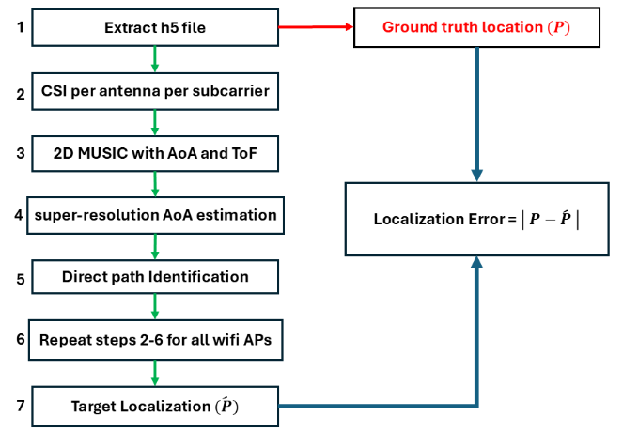
SpotFi steps

Slide 4



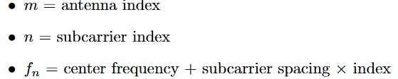

MUSIC Algorithm: Joint AoA and ToF Estimation
MUSIC = MUltiple SIgnal Classification
Assumes received signal :
Steps
  Form covariance matrix R=XX^H
  Eigenvalue decomposition: R=EΛE^H
  Separate signal (E_s) and noise (E_n) subspaces using eigenvalue gaps
  Construct steering vectors a(θ)
  MUSIC spectrum:
  Peak of P(θ) corresponds to AoA estimate
  Enables super-resolution beyond classical beamforming

Slide 5
Dataset: WiFi Indoor Localization Dataset (WILD-v2)
17276 Received signals
Complex signal
RSSI
6 WiFi AP
Known Locations
234 subcarriers
4 antennas

Slide 6
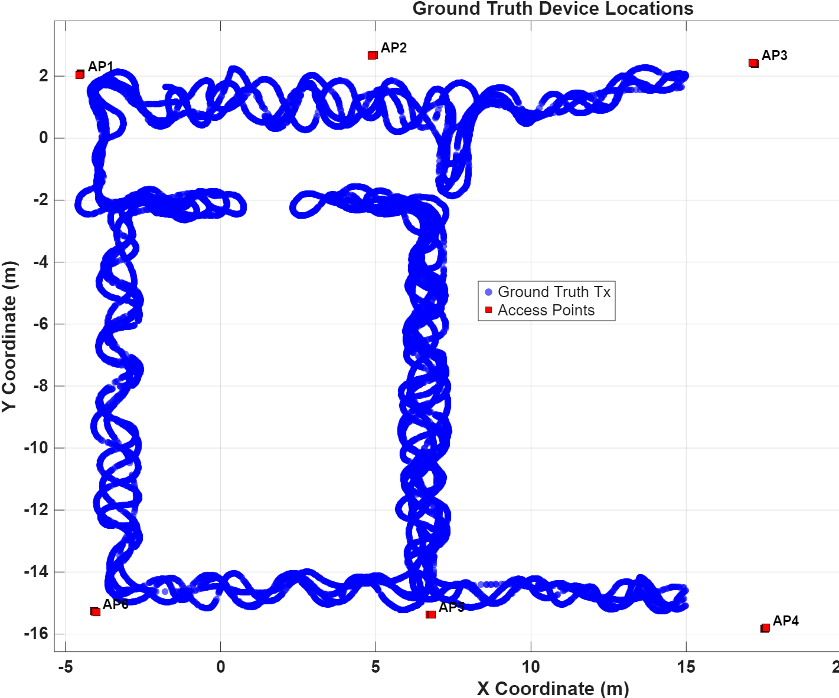
Scene description
1 packet per location
MUSIC needs multiple packets to detect multipaths
Usual approach: take multiple packets for same location
Our approach: take closely located location CSI as multiple packets

Slide 7
NARROWBAND VS wIDEBAND MUSIC
Using narrowband (taking only first 30 subcarriers will have lower overall bandwidth)
We have 234 subcarriers
Take 30 subcarriers (uniformly spaced across 234 subcarriers)

Slide 8
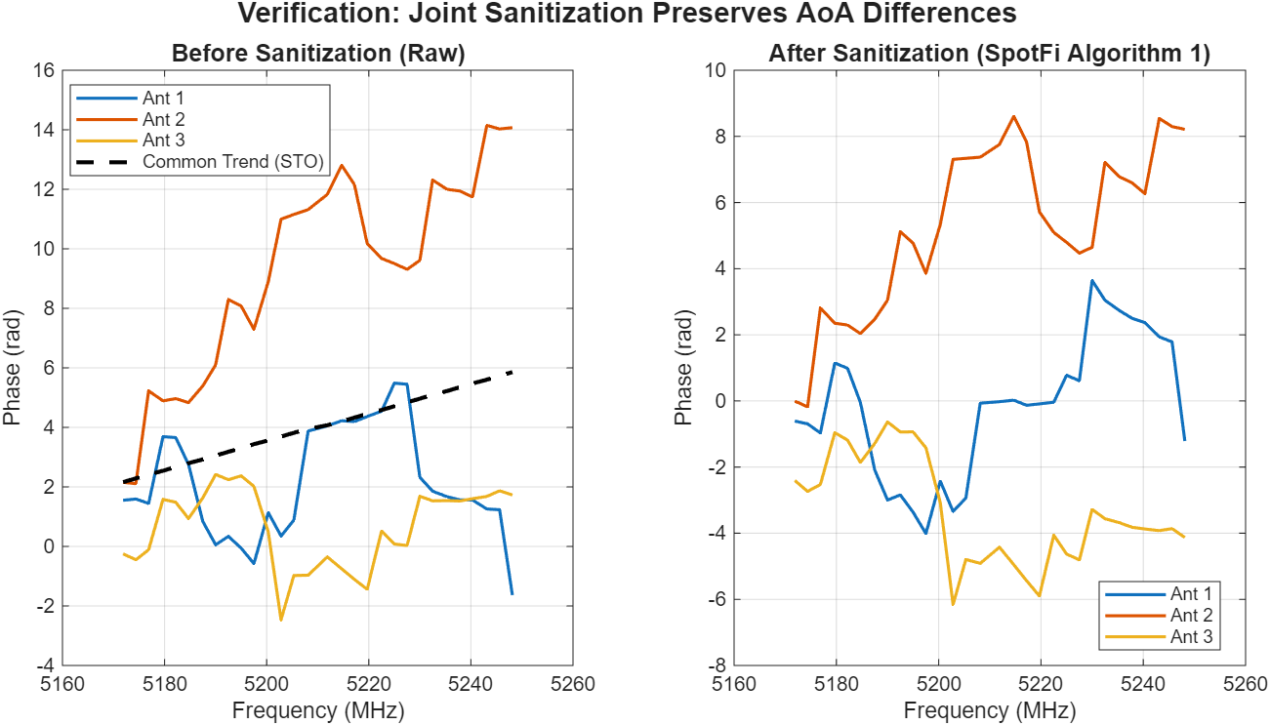
CSI SANITIZATION and smoothing

Slide 9
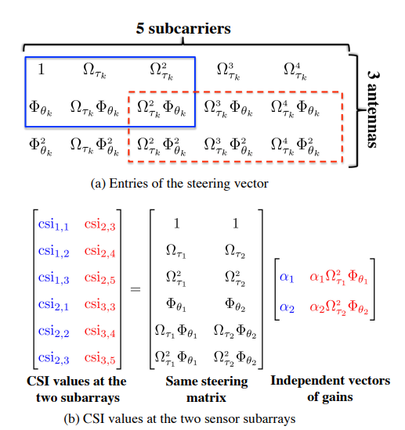
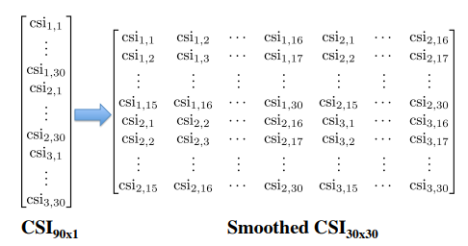
CSI smoothing

Slide 10
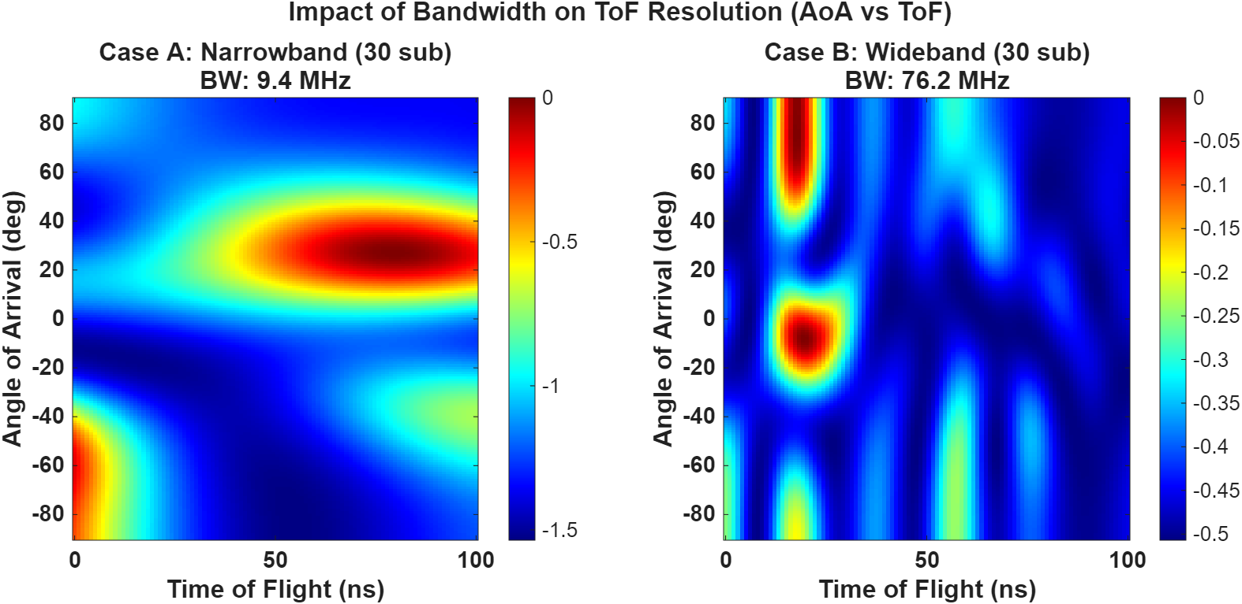
NARROWBAND VS wIDEBAND MUSIC

Slide 11
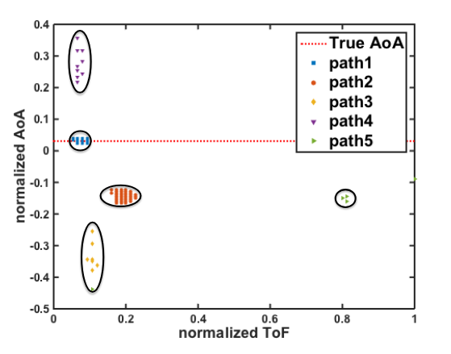
Utilizing multiple packets

Slide 12
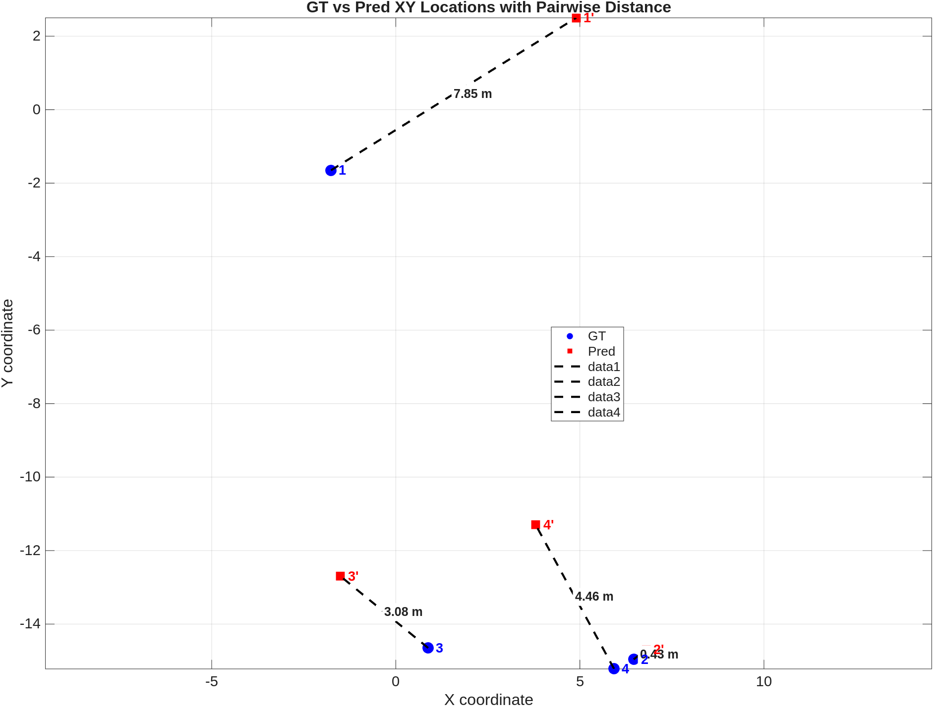
Results
Mean error = 3.67 m

Slide 13
Challenges
Finding multi-packets datasets
Difficulty in finding clusters and peaks

Slide 14
Conclusion
We implemented Spotfi algorithm for localization using publicly available dataset
More ablation study required to find optimal number of antennas, subcarriers, etc.
  Will include in final report

Slide 15
References
 | Kanishka and Roshan Ayyalasomayajula. Wi-Fi Indoor Localization Dataset (WILD-v2). https://kaggle.com/competitions/wildv2, 2022. Kaggle. M. Kotaru, K. Joshi, D. Bharadia, and S. Katti, “SpotFi: Decimeter Level Localization Using WiFi,” in Proc. ACM SIGCOMM, London, UK, 2015, pp. 269–282, doi:10.1145/2785956.2787487.

